Slide 1
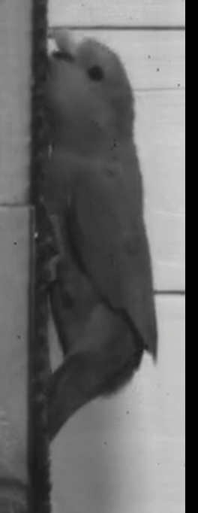
All points
sub1
beakbase
grid1
beaktip
head
mandtip
mandbase
eye
headbase
wing
This distance is 10 cm
topclaw
ankle
botclaw
grid2
tailbase
tailtip
sub2

Slide 2
All points
COM

Slide 3
All points

Slide 4
Distance of COM to substrate
COM

Slide 5
Distance from top support to tail tip

Slide 6
Proportion of time tail is in contact with substrate

Slide 7
Proportion of time maxilla is in contact with substrate

Slide 8
Proportion of time mandible is in contact with substrate

Slide 9
Proportion of time foot is in contact with substrate

Slide 10
Tail angle

Slide 11
Body axis angle

Slide 12
Hindlimb angle
Limb protraction (+) /retraction (-)
COM

Slide 13
Tail retraction angle
retraction (-)
COM

Slide 14
Beak protraction angle
Beak protraction (+)
COM

Slide 15
Neck angle/neck flexion

Slide 16
Craniofacial joint angle

Slide 17
mandible joint angle

